Slide 1
Long Report
Effective Communication

Slide 2
LONG REPORT
A long report generally covers more complex issues and is considerably longer than the short reports.
In addition to the body (text, discussion) of the report where details are fleshed out.
I Prefatory Sections.
II Supplementary Sections
prefatory parts include the cover and external title, title fly and internal title, letter or memorandum
of transmittal, table of contents, and an executive summary.

Slide 3
Definition of Report
12-<number>
“A report is a written or oral message presenting information that will help a decision maker to solve a business problem.”
“A report is a communication from someone who has some information to someone who wants to use that information.”

Slide 4
Report and Formal Report
A report is a planned, organized, factual presentation of information prepared for a specific purpose and for a specific audience.
A formal report is prepared for a decision-making audience and typically requires in-depth investigation and team collaboration.

Slide 5
LONG REPORT
Documentation within the report is of two types: explaining (referring to content) or citing (quote) the Sources of your information. Important here is your decision as to the format of your citations.
Make a decision early to establish a consistent style, perhaps following the format of the Modern Language Association (MLA) or that of the American Psychological Association (APA).
One of two commonly used style guides for formatting research papers..

Slide 6
Long (Formal) Report
I Prefatory Sections.
II Supplementary Sections.
III Presentation of the long Report.

Slide 7
Modern Language Association (MLA)
MLA style has been widely adopted by schools, academic departments, and instructors for over half a century.
The association's guidelines are also used by over 1,100 scholarly and literary journals, newsletters, and magazines and by many university and commercial presses.
The MLA's guidelines are followed throughout North America and in Brazil, China, India, Japan, Taiwan, and other countries around the world.
*Visiting scholars are asked to be sure to return all library materials before leaving the University.

Slide 8
American Psychological Association (APA).
The American Psychological Association is the largest scientific and professional organization representing psychology in the United States.
APA is the world's largest association of psychologists, with more than 1,34,000 researchers, educators, clinicians, consultants and students as its members.
The mission of APA is to advance the creation, communication and application of psychological knowledge to benefit society and improve people's lives.

Slide 9
LONG REPORT
Finally, effective presentation of your long report is easier today with word processors. When using a word processor ? writing, editing, revising, and typing the report is your final task. Also, be sure to apply the seven C‘s.
*A quotation from or reference to a book, paper, or author, esp. in a scholarly work.

Slide 10
Formal language
You tend to find formal language in academic journals or official documents and notices where it brings an extra degree of seriousness to the subject. As a general rule, it isn't appropriate for everyday situations.
Here are some examples of formal words with their equivalents in standard English - notice that the formal words are often longer than the standard terms.

Slide 11
Examples of formal words
Standard English Formal English
Think Cogitate
Buy Purchase
Food Comestibles
Poor Penurious
Hate Abominate
Fee, Salary Emoluments
A drink Beverage
Using formal English in everyday situations can make your writing sound pompous (self-important) or pretentious. You may also make what you've written sound unintentionally funny, as some writers deliberately (intentionally) choose formal vocabulary to create a comic effect (causing laughter or amusement) .

Slide 12
Long (Formal) Report
Long reports are a mix of informative and persuasive information.
A long report may also be called "formal," but not formal in the sense of language usage.
In fact, the principles of the seven C's may also be applied.

Slide 13
Long (Formal) Report
We label a Report Formal when it includes
More detail,
More prefatory information,
More Visuals, and
More supplementary forms of support.
Topics are often involved and complex.

Slide 14
Report Functions
An informational report presents the facts but does not analyze the information, draw conclusions, or make recommendations.
Annual report—summarizes a company’s accomplishments, finances, and significant events
Progress report—updates status of a project
Travel or trip report—summarizes travel agenda
Minutes—record of proceedings of a meeting

Slide 15
Report Functions
An analytical report presents information, analyzes the information, draws conclusions, and sometimes includes recommendations.
  Feasibility report—examines a proposed course of action
  Justification report—explains or recommends an action

Slide 16
Formal Report
A formal report is prepared for a decision making audience and typically requires in-depth investigation and team collaboration.
A formal report includes three parts:
  Preliminary parts precede report body.
  Report body contains information and visuals to support the report objective.
  Supplementary parts follow the report body.

Slide 17
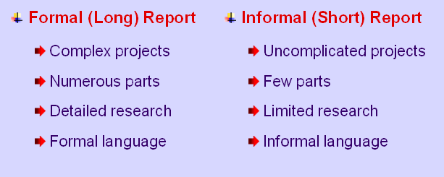
Report Types

Slide 18
Types of Report
12-<number>
Bases of Classification | Type of Reports
1. Legal Formalities | Informal report Formal report
2. Use / Intent / Function | Informational report Analytical report
3. Source | Voluntary report Authorized report

Slide 19
Types of Report
12-<number>
4. Frequency | Daily report Periodic report Special report
5. Target audience | Internal report External report
6. Length | Long report Short report

Slide 20
Contents of A Long Report
12-<number>
1. Prefatory parts
2. Body of the Report
3. Supplementary parts

Slide 21
Contents of A Long Report
12-<number>
Major Sections | Contents /Parts in each section
1. Prefatory parts | a) Cover page / Title Fly b) Title page c) Letter of transmittal d) Acknowledgement e) Table of contents f) Executive summary

Slide 22
Contents of A Long Report
12-<number>
2. Body | a) Introduction: Problem statement Objectives of the report Scope of the study Methodology (Sources and Methods of collecting data) Limitations b) Findings c) Conclusion d) Recommendations

Slide 23
Contents of A Long Report
12-<number>
3. Supplements | a) Bibliography b) Appendices c) Glossary

Slide 24

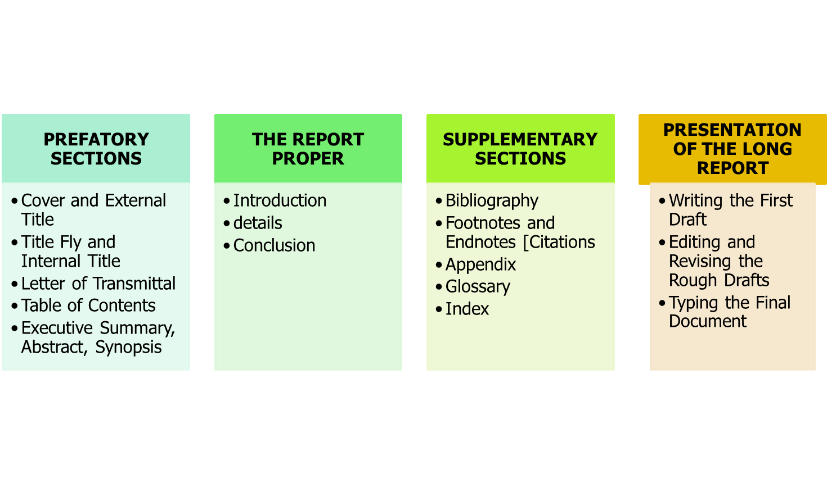

Slide 25
Preliminary Parts
Title page—title, author, affiliation, date, receiver
Transmittal message—official submission of report
Table of contents—page numbers of report parts
List of illustrations—titles and page numbers of visuals
Executive summary—summary of key points

Slide 26
Report Body
Introduction—statement of authorization, purpose, background, scope (capacity), limitations, research sources, order of presentation
Text—details to support objective
Terminal section or conclusion—summary of key points, conclusions, and recommendations

Slide 27
Supplementary Parts
References (APA) or works cited (MLA) – alphabetical list of sources cited
Appendix—supplemental information not necessary to understand the report or too lengthy to include in the body

Slide 28
Long (Formal) Report
I Prefatory Sections.
II Supplementary Sections.
III Presentation of the long Report.

Slide 29
Long (Formal) Report
I- Prefatory Sections.
    Cover and External Title
    Title fly and Internal Title
    Letter of Memorandum of transmittal
    Table of contents
    Executive Summary
    Abstract
    Synopsis

Slide 30
1 - Cover and External Title
Many reports combine the cover page and title page as the firs page. You can even purchase professionally produced covers that have space for a title.
Even large companies have reports printed with special, visually appealing covers.

Slide 31
Five suggestions
A report title should indicate briefly and clearly what the report covers.
Your reader get an initial impression in the title: Give careful thought to being concise and clear
Here are five suggestions
1. Remember the five W's:
    Who, What, When, where, why

Slide 32
Example Remember the five W's
As an example, suppose your report discusses a strategy for a company called Life Plus that markets exercise bicycles in Canada.
You could use this analysis:
  Who Life Plus
  What Marketing strategy
  When 2013
  where, Canada
  why To increase sales
  A new Marketing Emphasis for 20xx Canadian Sales Canadian Sales ways to Improve our market.

Slide 33
Five suggestions for Report cover
1. Remember the five W's:
  Who, What, When, where, why
2- Keep title short. Eight to ten words is desirable try
to omit articles the, a, an – whenever possible
3- Consider subtitle, often indicate with a colon.
4. Avoid title that are vague, (unclear)
extremely short:
5. Eliminate judgment terms.

Slide 34
1- Cover
Purpose is to protect the contents of the report
  Presents the Title
  Writer’s name
  Date of submission
  Company’s name and/or logo

Slide 35
2- Title page
A title page is the front page of report.
Contains title and subtitle
“prepared for” name, title, address of person for whom report is intended
“prepared by” author’s name, title, company, dept., address, phone, fax
Date of submission

Slide 36
Title Page
1. the title of the report
2. the name, title and address of the person group that authorized the report prepared for submitted to
3. the name, title and address of the person, group etc that prepared the report, prepared by, submitted by
4. the date on which the report was submitted.
The title page signals the readers by giving the report title, author's name, name of person or organization to
whom the report is addressed, and date of submission. Choose title information but not long, A Report of, A Study of, or A Survey of

Slide 37
2 - Title fly and Internal Title
Title Fly
  It is a plain sheet of paper with the title of the report on it.
  Contains only the report title and is optional, follows cover page
  By definition the title fly is simply the sheet of paper between the cover and the internal title page. Immediately following that page is the internal title page, which has four parts: the title as stated on the exterior cover, the recipient of the report, the preparer, and the date.

Slide 38
3 - Letter of *Memorandum of transmittal
A cover letter or cover memorandum are names for the first prose (writing style) document of a report. Regardless of the formality of the report, it is conventional (predictable) to address the receiver of the report as if you're. writing a letter as "Dear." Before looking at the five parts of a transmittal message,
It is an enlightening (informative) review of how a Middle East country handles a salutation in a cover letter.
  Most transmittal messages have five parts.
*Message, Communication

Slide 39
Five parts of a transmittal message
  Most transmittal messages have five parts.
  Authorization, include the name of the group or individual who requested the report
  Transmittal Details
  Background, Methodology
  Highlights
  Courteous Ending

Slide 40
3 - Transmittal Letter
Explains the purpose and content of the report
Precedes the title page
Acknowledges those who helped with the Report (if any)
Highlights parts of the report that may be of special interest
Discuss any problems
Offer any personal observations

Slide 41
3 - Transmittal Letter
It explain the report directly to the reader
It present an over view to reader.
Written in informal tone.
Generally close with goodwill messages

Slide 42
Letter of Transmittal Template
MIDWESTERN RESEARCH, INC.
1732 Midday Avenue
Chicago, IL 60607
Telephone: 312.481.2919
April 13, 2005
Mr. W. Norman W. Bigbee
Vice President in Charge of Sales
Allied Distributors, Inc.
3131 Speedall Street
Akron, Ohio 44302
Dear Mr. Bigbee:
Here is the report on the four makes of subcompact automobiles you asked me to compare last January 3.
To help you in deciding which of the four makes you should buy as replacements for your fleet, I gathered what I believe to be the most complete information available. Much of the operating information comes from your own records. The remaining data are the findings of both consumer research engineers and professional automotive analysts. Only my analyses of these data are subjective.
I sincerely hope, Mr. Bigbee, that my analyses will help you in making the correct decision. I truly appreciate this assignment. And should you need any assistance in interpreting my analyses, please call on me.
Sincerely,
George W. Franklin
George W. Franklin
Associate Director

Slide 43
Letter of Authorization
A document requesting for preparation of report
Specifies problems scope and time, money special instruction and due date.
Letter of Acceptance
It confirms time, money, restrictions
and other detail.

Slide 44
4 - Table of contents
This table outlines the text and list Prefatory Parts
1. List preliminary items (transmittal letter, abstract) in your table of contents, numbering the pages with
small roman numerals. (List items that appear at the end of the report, such as glossary, appendix, notes and
bibliography section; number these pages with Arabic numerals, continuing the page sequence of the report
proper, where page no. 1ist the first page of your report text.
2. Include no heading in the table of contents not listed as headings or subheadings in the report; your
report text may, however, contain certain sub-headings.
3. Use different types of styles and indentations to show the various levels of heads.

Slide 45
4 - Table of contents
List of headings along with the page numbers
Helps readers to find what they want and see the
overall organization and approach of the report.

Slide 46
Table of content Template
TABLE OF CONTENTS
Executive Summary........................... 1
Introduction ....................................... 2
Background
Purpose
Scope
Research Questions
Report Organization
Research and Analysis...................... 4
Methodology
Findings
Conclusions & Recommendations..... 6
Appendices........................................ 7
Appendix 1: Survey questions
Appendix 2: Client proposal
Appendix 3: PowerPoint slides

Slide 47
Summary
Summary
If you have a large book containing a story or a play, you are not tempted to go for it thinking it would consume a lot of time. However, if there is a short version of the same play or story containing the main points, most people evince (show) interest and read it. Thus, summary is nothing but rewriting a work of prose to make it short and condensed.
There is no attempt by the person writing the summary to be judgmental, and he does not pass a personal remark or opinion. He tries to present the viewpoint of the author just keeping it short.
Summary is quite short, maybe just a page or two at the maximum no matter how long a work like a story or a play may be.

Slide 48
Synopsis
Synopsis is more or less the same as a summary as it has been defined in various dictionaries as an outline, condensation, or even summary of the main points of a work, book or an article. Synopsis carries the gist (general idea) of a work of prose (text) without presenting the viewpoint of the writer of the synopsis.
Both synopsis and summary retain the viewpoint of the author, but a summary is very short, may be a page or two long but synopsis can be at time 25-30 pages long.

Slide 49
5 - Executive Summary
Reviews the essential points of a report
  Subject
  Purpose
  Scope (range)
  Methods
  Conclusions
  Recommendations
Provides the reader with enough information to make an informed decision
Usually 10% of the length of the report

Slide 50

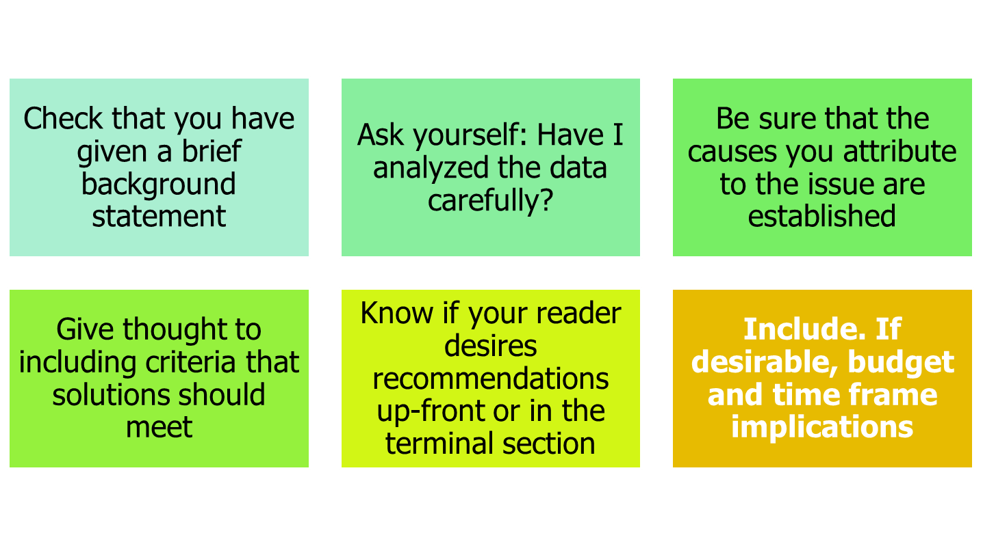
An executive Summary should be able to stand alone

Slide 51
Synopsis or Executive Summary
A synopsis is a brief overview (one page or less) of report's most important point. It is also called
abstract. Executive summary is a fully developed mini version of the report and is comprehensive.
1. Make your summary able to stand alone in
meaning ­ a mini-report
2. Make it intelligible to the general reader. Readers
of summaries will vary widely in expertise, perhaps
much more than those who read the report itself.
So translate all technical data into plain English.
3. Add no new information. Simply summarize the
report
4. Stick to the order of your report
5. Emphasize only major points

Slide 52
6 - Abstract
Condensed version of the writing that highlights the major points covered
Concisely describes the content and scope of the writing
Reviews the contents in an abbreviated form
Abstracts can be descriptive or informative

Slide 53
6 - Abstract
  Descriptive Abstract
    Provides
    Purpose
    Methods
    Scope
    Dose not provide
    Results
    Conclusions
    Recommendations
    Introduces the subject to the readers
    Brief (< 100 words)

Slide 54
6 - Abstract
Informative Abstracts
  Communicate specific information from the report
    Purpose
    Methods
    Scope
    Results
    Conclusions
    Recommendations
  Allow readers to decide whether they need to read the entire report
  Brief (no longer than 250 words)

Slide 55
List of Illustrations
For simplicity sake, some reports prefer to include all visual aid as illustration or exhibits.
Put the list of figures and table on separate page if they won't fit on one page with the table of content.

Slide 56
List of Illustrations
Illustrations along with page numbers
Two categories
  List of figures
  List of tables
Appears on a separate page immediately following the table of contents
Title and page number of every illustration must be included
Lists all figures and pictures..

Slide 57
Supplementary parts of
Long Report
Supplementary parts of a long report include (if needed) a bibliography, footnotes or endnotes (citations), if they are necessary; appendixes; a glossary, if needed; and an index, if the report is especially long.

Slide 58

Formal Report
A formal report includes three parts:
Preliminary parts precede report body.
Report body contains information and visuals to support the report objective.
Supplementary parts follow the report body.

Slide 59
Preliminary Parts
Title page—title, author, affiliation, date, receiver
Transmittal message—official submission of report
Table of contents—page numbers of report parts
List of illustrations—titles and page numbers of visuals
Executive summary— summary of key points

Slide 60
Report Body
Introduction—statement of authorization, purpose, background, scope (capacity), limitations, research sources, order of presentation
Text—details to support objective
Terminal section or conclusion—summary of key points, conclusions, and recommendations

Slide 61
Supplementary Parts
References (APA) or works cited
(MLA) – alphabetical list of sources cited
Appendix—supplemental information not necessary to understand the report or too lengthy to include in the body

Slide 62
Long (Formal) Report
1 Prefatory Sections
  A. Cover and External Titles
  B. Title Fly and Internal Title
  C. Letter or Memorandum of transmittal
  D. Table of Contents
  E. Executive Summary, Abstract, Synopsis
  *Fly (wing)

Slide 63
II- Supplemental Sections
A. *Bibliography
B. *Footnotes and Endnotes *(Citations)
C. *Appendix
D. *Glossary
E. *Index
*Bibliography (A list of books and articles on a subject)
*Citation (Document),
*Appendix (Preface).
*Glossary (Vocabulary, word list,)
*Index (Catalog, guide, key)

Slide 64

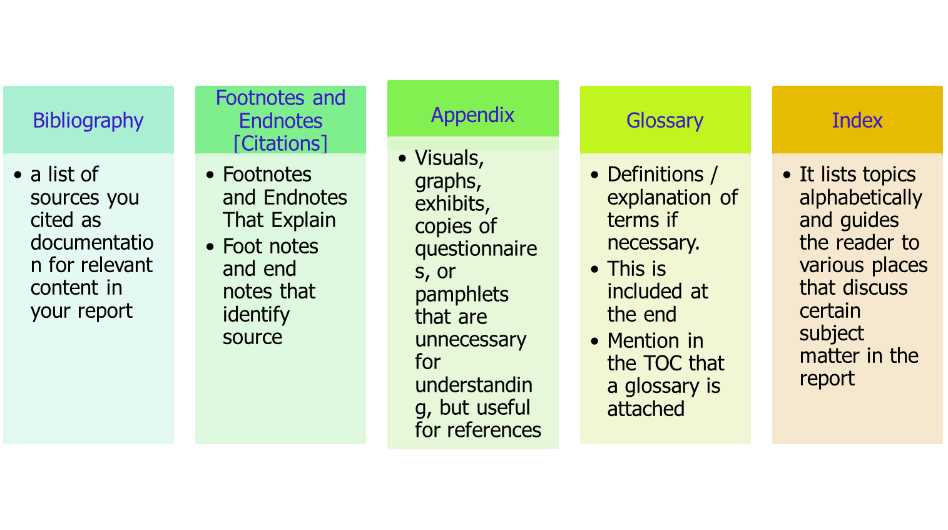

Slide 65
Endnote and Footnote
A footnote will contain the source of the information, or additional information about the text contained the document.
An endnote is additional information or credits given at the end of the document instead of at the end of each page.

Slide 66
Contents of A Long Report
12-<number>
Major Sections | Contents /Parts in each section
1. Prefatory parts | a) Cover page / Title Fly b) Title page c) Letter of transmittal d) Acknowledgement e) Table of contents f) Executive summary

Slide 67
Definition of PREFATORY
Relating to, or constituting a preface (introduction) prefatory.
Introductory to a book, essay
Examples of PREFATORY
The speaker made some prefatory remarks.
Each chapter in the book has a prefatory *quotation (reference).
*Quotation. (Reference, line, passage, Quote).

Slide 68
PREFATORY SECTIONS
Someone within your (organization requests that you investigate a problem.
Someone requests information.
The request may be simple, often oral:
"Look into the issue of salary levels among our personnel in Pakistan.
"Give me a report on changes in retirement benefits.
"Submit to the Board some options on computer
hardware."

Slide 69
PREFATORY SECTIONS
Writing in ones second language is *considerably more difficult than writing in one’s *native language.
Often the required report is first written in the native language of the foreign *subsidiary and then translated into English.
*Considerably (Significantly, very much)
*Native ( National, local, Resident)
*subsidiary ( Secondary, additional, Supplementary)

Slide 70
Cover and External Title
Even large companies have reports printed with special, visually appealing covers.
Many reports combine the cover page and title page as the firs page.
You can even purchase professionally produced covers that have space for a title.

Slide 71
Introduction
Context—basic background information
Purpose—what report is intended to accomplish
Scope—what report covers (and perhaps what it doesn’t cover)
Procedures—how report was compiled (especially how information was gathered).
Limitations—problems, shortcomings, items not covered in report

Slide 72
Body
Problem
  Explanation and breakdown
  Background/causes
  Negative effects
Solutions
  Explanation and breakdown
  Implementing the solutions
  Benefits

Slide 73
Contents of A Long Report
12-<number>
2. Body | a) Introduction: Problem statement Objectives of the report Scope of the study Methodology (Sources and Methods of collecting data) Limitations b) Findings c) Conclusion d) Recommendations

Slide 74
Conclusion
Summary of Findings—summary of information about problem and solutions from body of report
Recommendations—list of specific steps the reader should now take to implement solutions

Slide 75
Transmittal Document (1 page)
Letter or memo that accompanies report
Brief summary of report context and contents
Thanks reader for cooperation/interest
Builds positive relationship with reader
Uses standard forms

Slide 76
Title Page (1 page)
Title of report
Name and title of writer
Name and title of reader
Name of company or organization
Date of submission
Centered on page

Slide 77
Abstract
Summary of report’s contents and recommendations
Designed to stand alone
Formatted as one paragraph
Abstract as title

Slide 78
Table of Contents
List of all headings exactly as they appear in report and starting page numbers
Lower case Roman numerals (i, ii, iii, iv, etc.) for front matter, beginning with list of illustrations
Arabic numerals (1, 2, 3, etc.) for rest of report
Table of Contents or Contents as title

Slide 79
Glossary
Defines all potentially unfamiliar words, expressions, or symbols
Need determined by audience
Alphabetizes terms
Lists symbols in order of appearance

Slide 80
Back Matter—after text of report
Appendixes:
  An index is an alphabetical list of names, places and subjects mentioned in the report, along with the page on which they occur. They are rarely included in unpublished reports.
Bibliography:
  A bibliography is a list of source materials on a particular subject. In a formal report it shows what books and other library materials were consulted and it includes all the works mentioned in the footnotes.

Slide 81
Appendixes
They contain material related to the report but not included in the text because they were lengthy or not directly relevant. They include:
  1. Statistics or measurements
  2. Maps
  3. Complex formulas
  4. Long quotations
  5. Photographs
  6. Related correspondence (letters of inquiry etc.)
  7. Texts of law, regulations etc.

Slide 82
Appendixes
Supplementary material, such as interview questions, survey questions, additional figures and illustrations, copies of relevant sources, other relevant documents (anything that you want the reader to have access to but that doesn’t fit directly into your report)
Includes title listed on Table of Contents (e.g. Appendix A: Interview Questions for Bill Gates)
Each appendix a separate page or pages

Slide 83
Bibliography
As part of the reference matter, it follows the appendix or appendices.
List of sources
Title and format depend on specific documentation format
APA (American Psychological Association)— References
MLA (Modern Language Association)—Works Cited

Slide 84
Index
A alphabetized list of report topics that includes the page on which the topic appears
Usually reserved for long, complex reports.

Slide 85
Contents of A Long Report
12-<number>
3. Supplements | a) Bibliography Appendices Glossary Index

Slide 86
III- Presentation of the long Report
A. Writing the first draft.
B. Editing and revising the first draft.
C. Typing the final document.

Slide 87
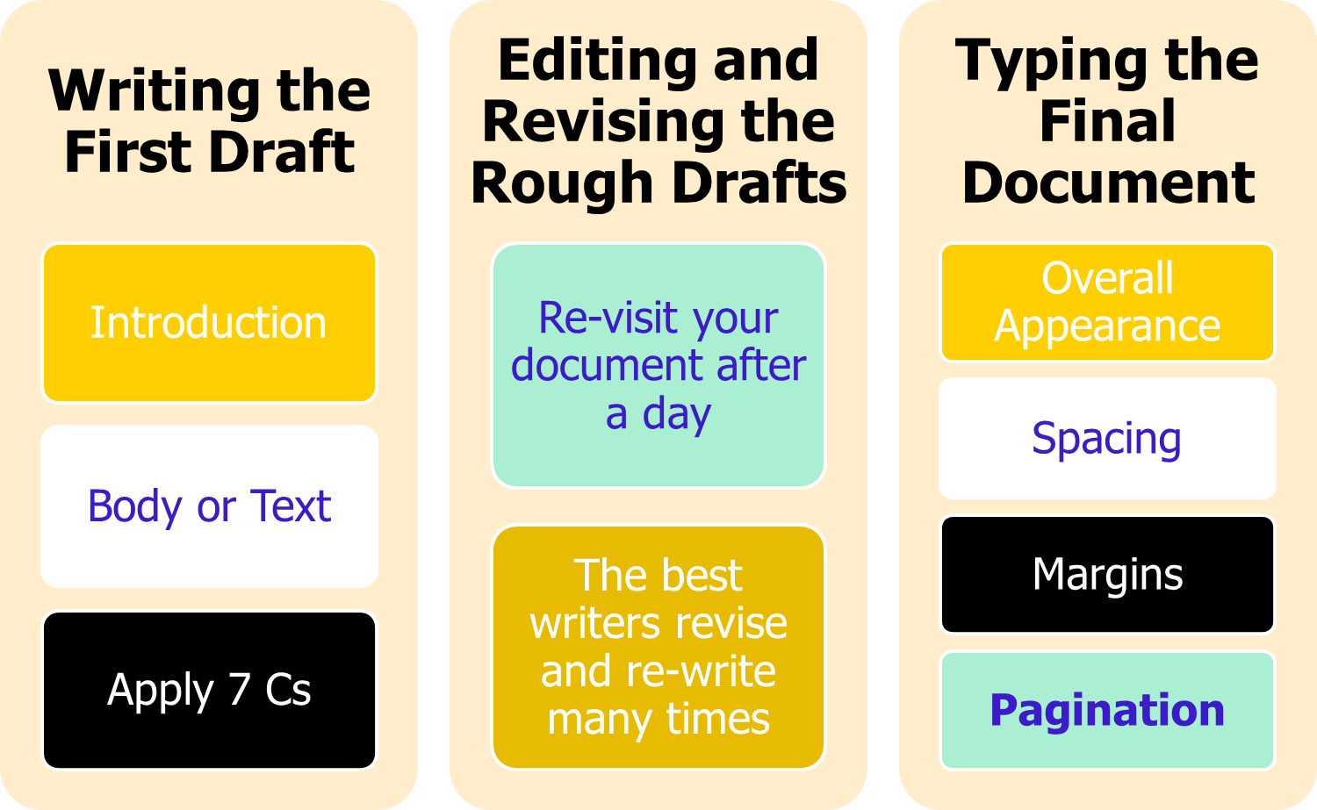
 |  | PRESENTATION OF THE LONG REPORT

Slide 88
Report-Writing Mechanics
Margins
  2-inch top margin on first page of report body, each preliminary part, and each supplementary part
  1-inch top margin on all subsequent pages
  1-inch bottom margin on all pages
  1-inch side margins or 1.5-inch side margin for left-bound reports

Slide 89
Report-Writing Mechanics (continued)
Spacing
  Double space and indent paragraphs or single space and double space between paragraphs.
  Center title page vertically and horizontally; provide equal white space between elements.
  Double space table of contents.
  Align first line of each reference at left margin and indent subsequent lines of each reference.

Slide 90
Report-Writing Mechanics (continued)
Reference and Parenthetical Citations
  Enclose direct quotes in quotation marks.
  Indent lengthy quotes from the body.
  Credit quotes and paraphrases both in the document and in the References or Works Cited.
  Enclose parenthetical citations in parentheses

Slide 91
Report-Writing Mechanics (continued)
Pagination
  Preliminary parts numbered with lowercase roman numerals (ii, iii, iv, etc.)
  Report body and supplementary parts numbered with Arabic numerals (2, 3, 4, etc.)
  Transmittal message neither numbered nor counted

Slide 92
What to Do First When Asked to
Complete a Report
1 Recognize dearly what is expected of you:
  Issues, problems, purpose, scope.
2. Realize who your audience of readers will be.
3. Get an idea of sources to which you may turn.
4. Understand when the report is to be completed.
5. Be sure of financial and time constraints:
costs, travel, release from work.
6. Ask if the authorizer wants progress reports.

Slide 93
Steps in Writing Report
12-<number>
1 - Selecting a report problem
2- Determination of purpose
3. Developing a working plan
4. Collection of information
5. Organizing information
6. Interpretation of information

Slide 94
Steps in Writing Report
12-<number>
7. Recommendation
8. Selecting the Method of writing
9. Making the outline
10. Preparing the final draft

Slide 95
Thanks
Wish you all the Best

